Slide 1
TRADEMYSKILLS-PROJECT SCRUM UPDATE
TEAM MEMBERS: TONI, FAIRUZ, PARSA, ALDAN

Slide 2
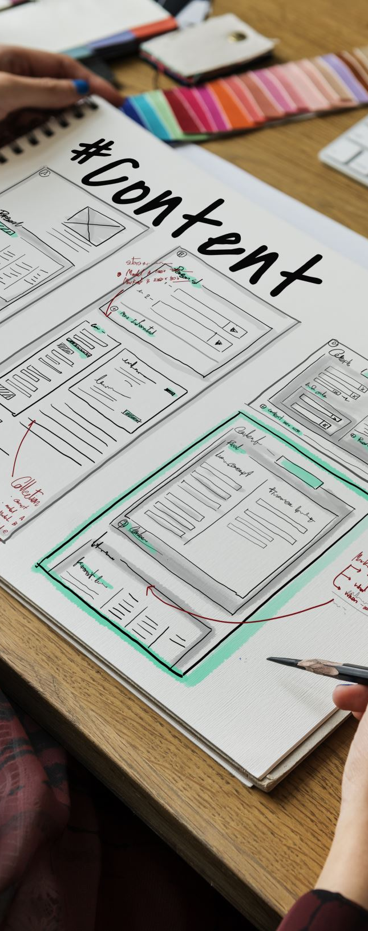
PROJECT OVERVIEW
Skill exchange web application
Users can:
Register/login
Post skills
Interact with others

Slide 3
PROJECT GOALS
Implement core system from labs
Build working user authentication system
Prepare demo-ready application

Slide 4
SYSTEM ARCHITECTURE
MVC Design:
Models – Database structure
Views – EJS template
Teck Stack:
Node.js
MongoDB
Bootstrap

Slide 5
TEAM WORK
CHALLENGES:
MVC Understanding
Merge conflicts
SOLUTIONS:
Following lab structure
Better communication

Slide 6
SELF REFLECTION
Challenging activity but valuable
Applied concepts learned in the lab to the demo
Learned more about teamwork

Slide 7
LEARNING OUTCOMES
Learnt how full stack apps work
Importance of teamwork
Git Workflow

Slide 8
FUTURE IMPROVEMENTS
Search and filtering system
Messaging system
Better UI
User security

Slide 9

DEMO OVERVIEW

Slide 10

ANY QUESTIONS?

